Slide 1



Freshco Hypermarket Capstone
Order level Analysis
Completion Rate Analysis
Customer Level Analysis
Delivery Analysis

Slide 2
Order Distribution by Location
Top Areas
Varying Popularity
Consistent Demand
HSR Layout (15,657)and ITI Layout (3,946)stand out with the highest order volumes, indicating strong local demand.
Several areas have relatively low order counts, suggesting uneven customer distribution across Bangalore.
Bellandur, Koramangala, and ITI Layout show consistently high order volumes throughout the day.
Order Distribution at Time Slot
Afternoon and Morning slots stand out with the highest total orders, indicating peak times for food delivery services
Late Night has the lowest total orders, reflecting a smaller but consistent late-night customer base.

Slide 3
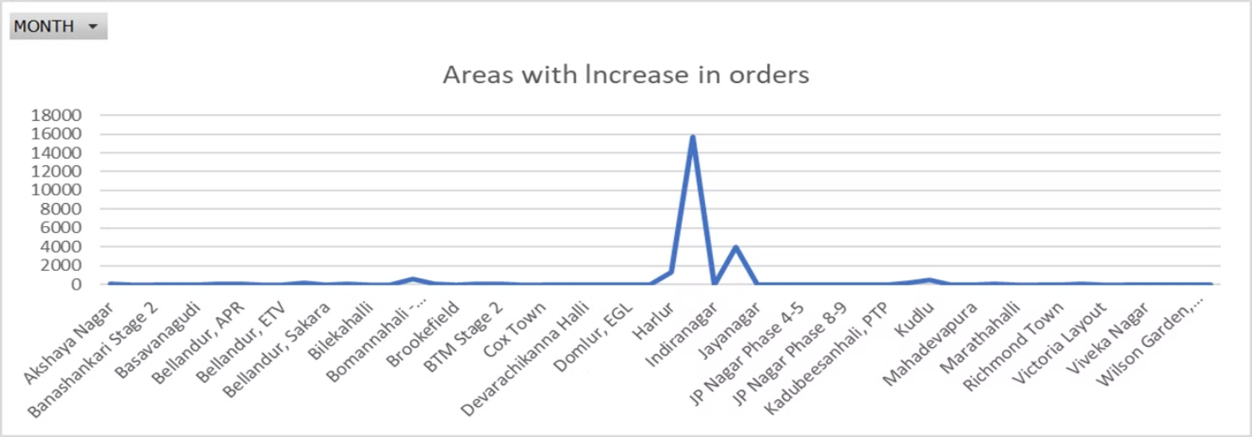
Areas having highest increase in monthly orders
HSR Layout, ITI Layout, and Harlur consistently demonstrate increase in the order volumes.
Bomannahali - MicoLayout, Kudlu, Koramangala, Ejipura exhibit comparatively lower order counts

Slide 4
Completion Rate Analysis
1
Consistent High Rates
2
Variations by Time
3
Larger Orders Succeed
Completion rates are consistently high across different days, time slots, and order sizes, indicating efficient operations.
There are slight variations observed on weekends (Saturday and Sunday) compared to weekdays (Monday to Friday) in some time slots. For instance, Saturday shows lower rates in the Late Night and Night slots compared to weekdays
Completion Rates start at 99.27% for single product orders and rise steadily, reaching a peak of 100.00% for orders of 12 products and above. Orders with 12 or more products consistently achieve 100% completion, highlighting optimized processes for bulk orders.
Wednesday has the highest average completion rate (99.49%), while Friday has the lowest (99.34%).

Slide 5


Customer Lifetime Value
Top Acquisition Sources
Snapchat (389.48)and Google (383.07)have the highest aggregated customer lifetime values, indicating strong long-term customer value.
Instagram has the lowest aggregated LTV among the listed sources at 349.11.
Seasonal Fluctuations
There is noticeable variability in the aggregated LTV from month to month. May has the highest LTV at 420.14, while September has the lowest at 319.06.It might be influenced by seasonal factors such as holidays or special events.

Slide 6
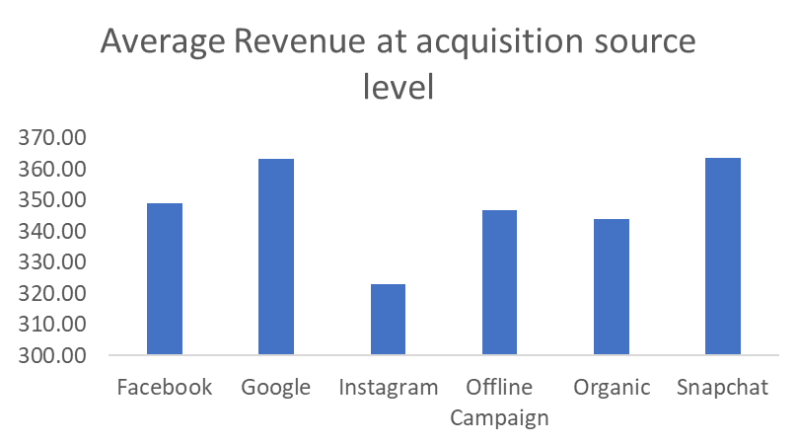
Revenue
Google and Snapchat have the highest average revenue per order, suggesting higher-value customers on these platforms with Snapchat having the highest at $363.52 and Google close behind at $363.05.
May has the highest average revenue per order at $401.83.
April follows with $376.09, also showing strong performance.
September has the lowest average revenue per order at $286.69, suggesting a potential seasonal or performance dip.
Instagram, on the other hand, has a lower average revenue per order at $322.85.
Notes:
Image on revenue

Slide 7





Order Ratings
Ratings by Slot
Morning slots tend to have slightly higher ratings compared to Late Night, which has the lowest average rating.
Ratings by Items
Ratings generally increase with the number of items ordered, with
higher ratings for larger orders.
Orders with 15 to 24 products tend to have higher average ratings,
ranging from 3.37 to 4.55.
Ratings and Discounts
Substantial discounts (15-21%) correlate with higher average ratings, indicating customer satisfaction.
Orders with low to moderate discounts show a diverse range of ratings, from as low as 3.00 to as high as 4.00
Orders with high discounts generally receive more consistent and higher ratings, typically ranging from 3.50 to 4.50

Slide 8

Delivery Charges and
Discounts
Late Night Charges
1
Delivery charges are highest during the Late Night slot, suggesting increased costs for late-hour deliveries.
2
Month wise
Months like January and February tend to have higher average delivery charges, especially in late night and evening slots.
3
Discount Variations
Discounts show significant variability across months and time slots, with higher percentages during promotional periods.

Slide 9

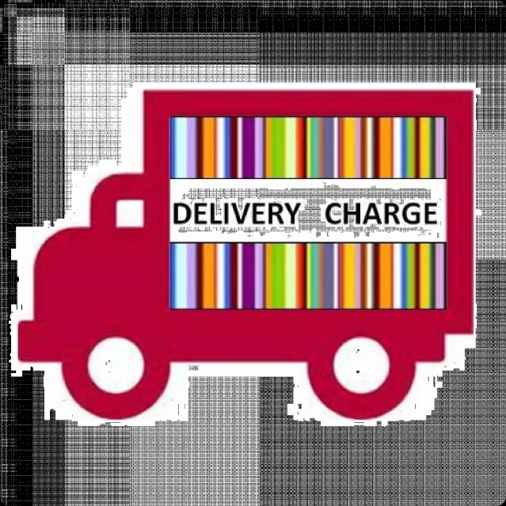
Delivery Charges and Ratings
Delivery Charges
Average Rating
$18.90 (Morning)
3.70
$19.20 (Afternoon)
3.68
$19.93 (Evening)
3.67
$32.09 (Late Night)
3.33
$20.82 (Night)
3.58

Slide 10

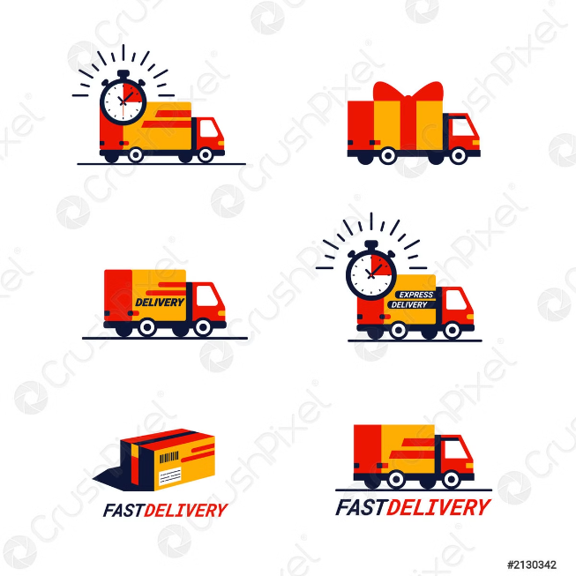



Delivery Time Analysis
Consistent Averages
Delivery times generally range between 8-11 minutes, with some variations across months and delivery areas, with June and July being the quickest months on average. Jan and Sep have slightly higher average times compared to other months
Weekday vs. Weekend
There is parity in delivery times between weekdays and weekends, indicating consistent operational efficiency both averaging 9 Min 45 Sec.
Time Slot Differences
Evening deliveries take the longest on average (10Min 15 Sec), while Night deliveries are the quickest (9 Min 20 Sec).

Slide 11
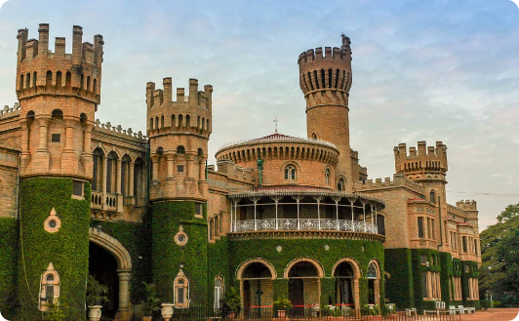
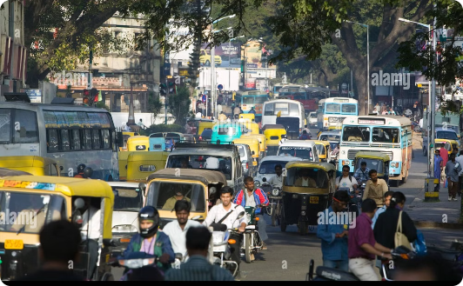
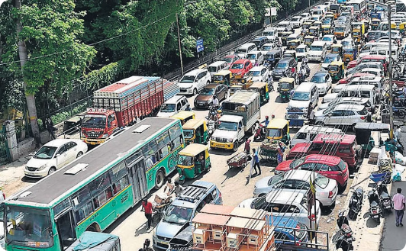
Delivery Area Performance
Efficient Hubs
Logistical Challenges
Infrastructure Impact
Areas like Bellandur and Koramangala have shorter average delivery times(ranging from 0:09:17 to 0:22:38), indicating operational efficiency.
Locations farther from central hubs, such as JP Nagar(0:31:13) and Jayanagar(0:37:39), experience longer delivery times.
Well-planned areas with good road networks, like HSR Layout (0:08:03)and Bommanahalli(0:18:18), see faster deliveries.

Slide 12
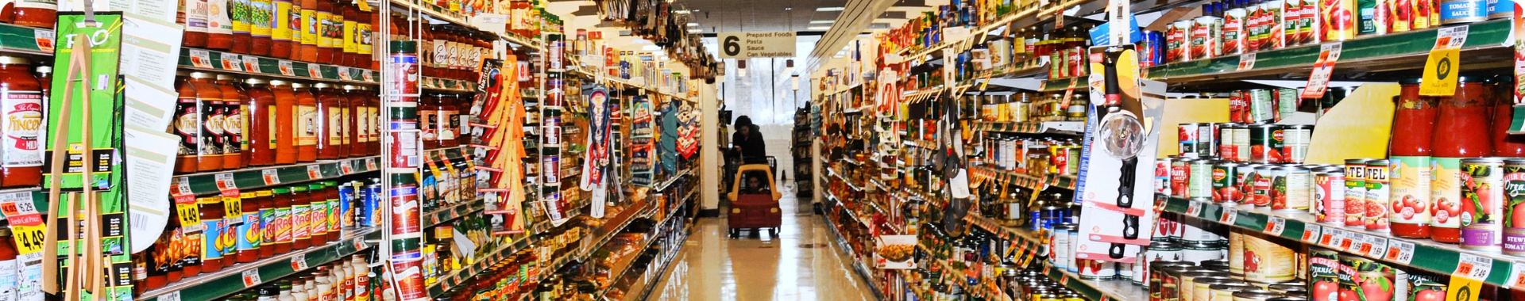
Key Takeaways
1
Uneven Demand
2
Operational Efficiency
3
Customer Insights
Certain areas like HSR Layout and ITI Layout have significantly higher order volumes, indicating potential for expansion.
High completion rates and consistent delivery times suggest robust operational processes, with room for improvement in specific areas.
Analyzing customer lifetime value, revenue per order, and ratings provides valuable insights to optimize acquisition and retention strategies.

Slide 13


